Slide 1

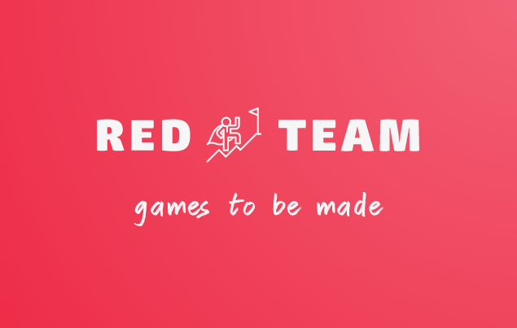
Adventura
Postmortem

Slide 2
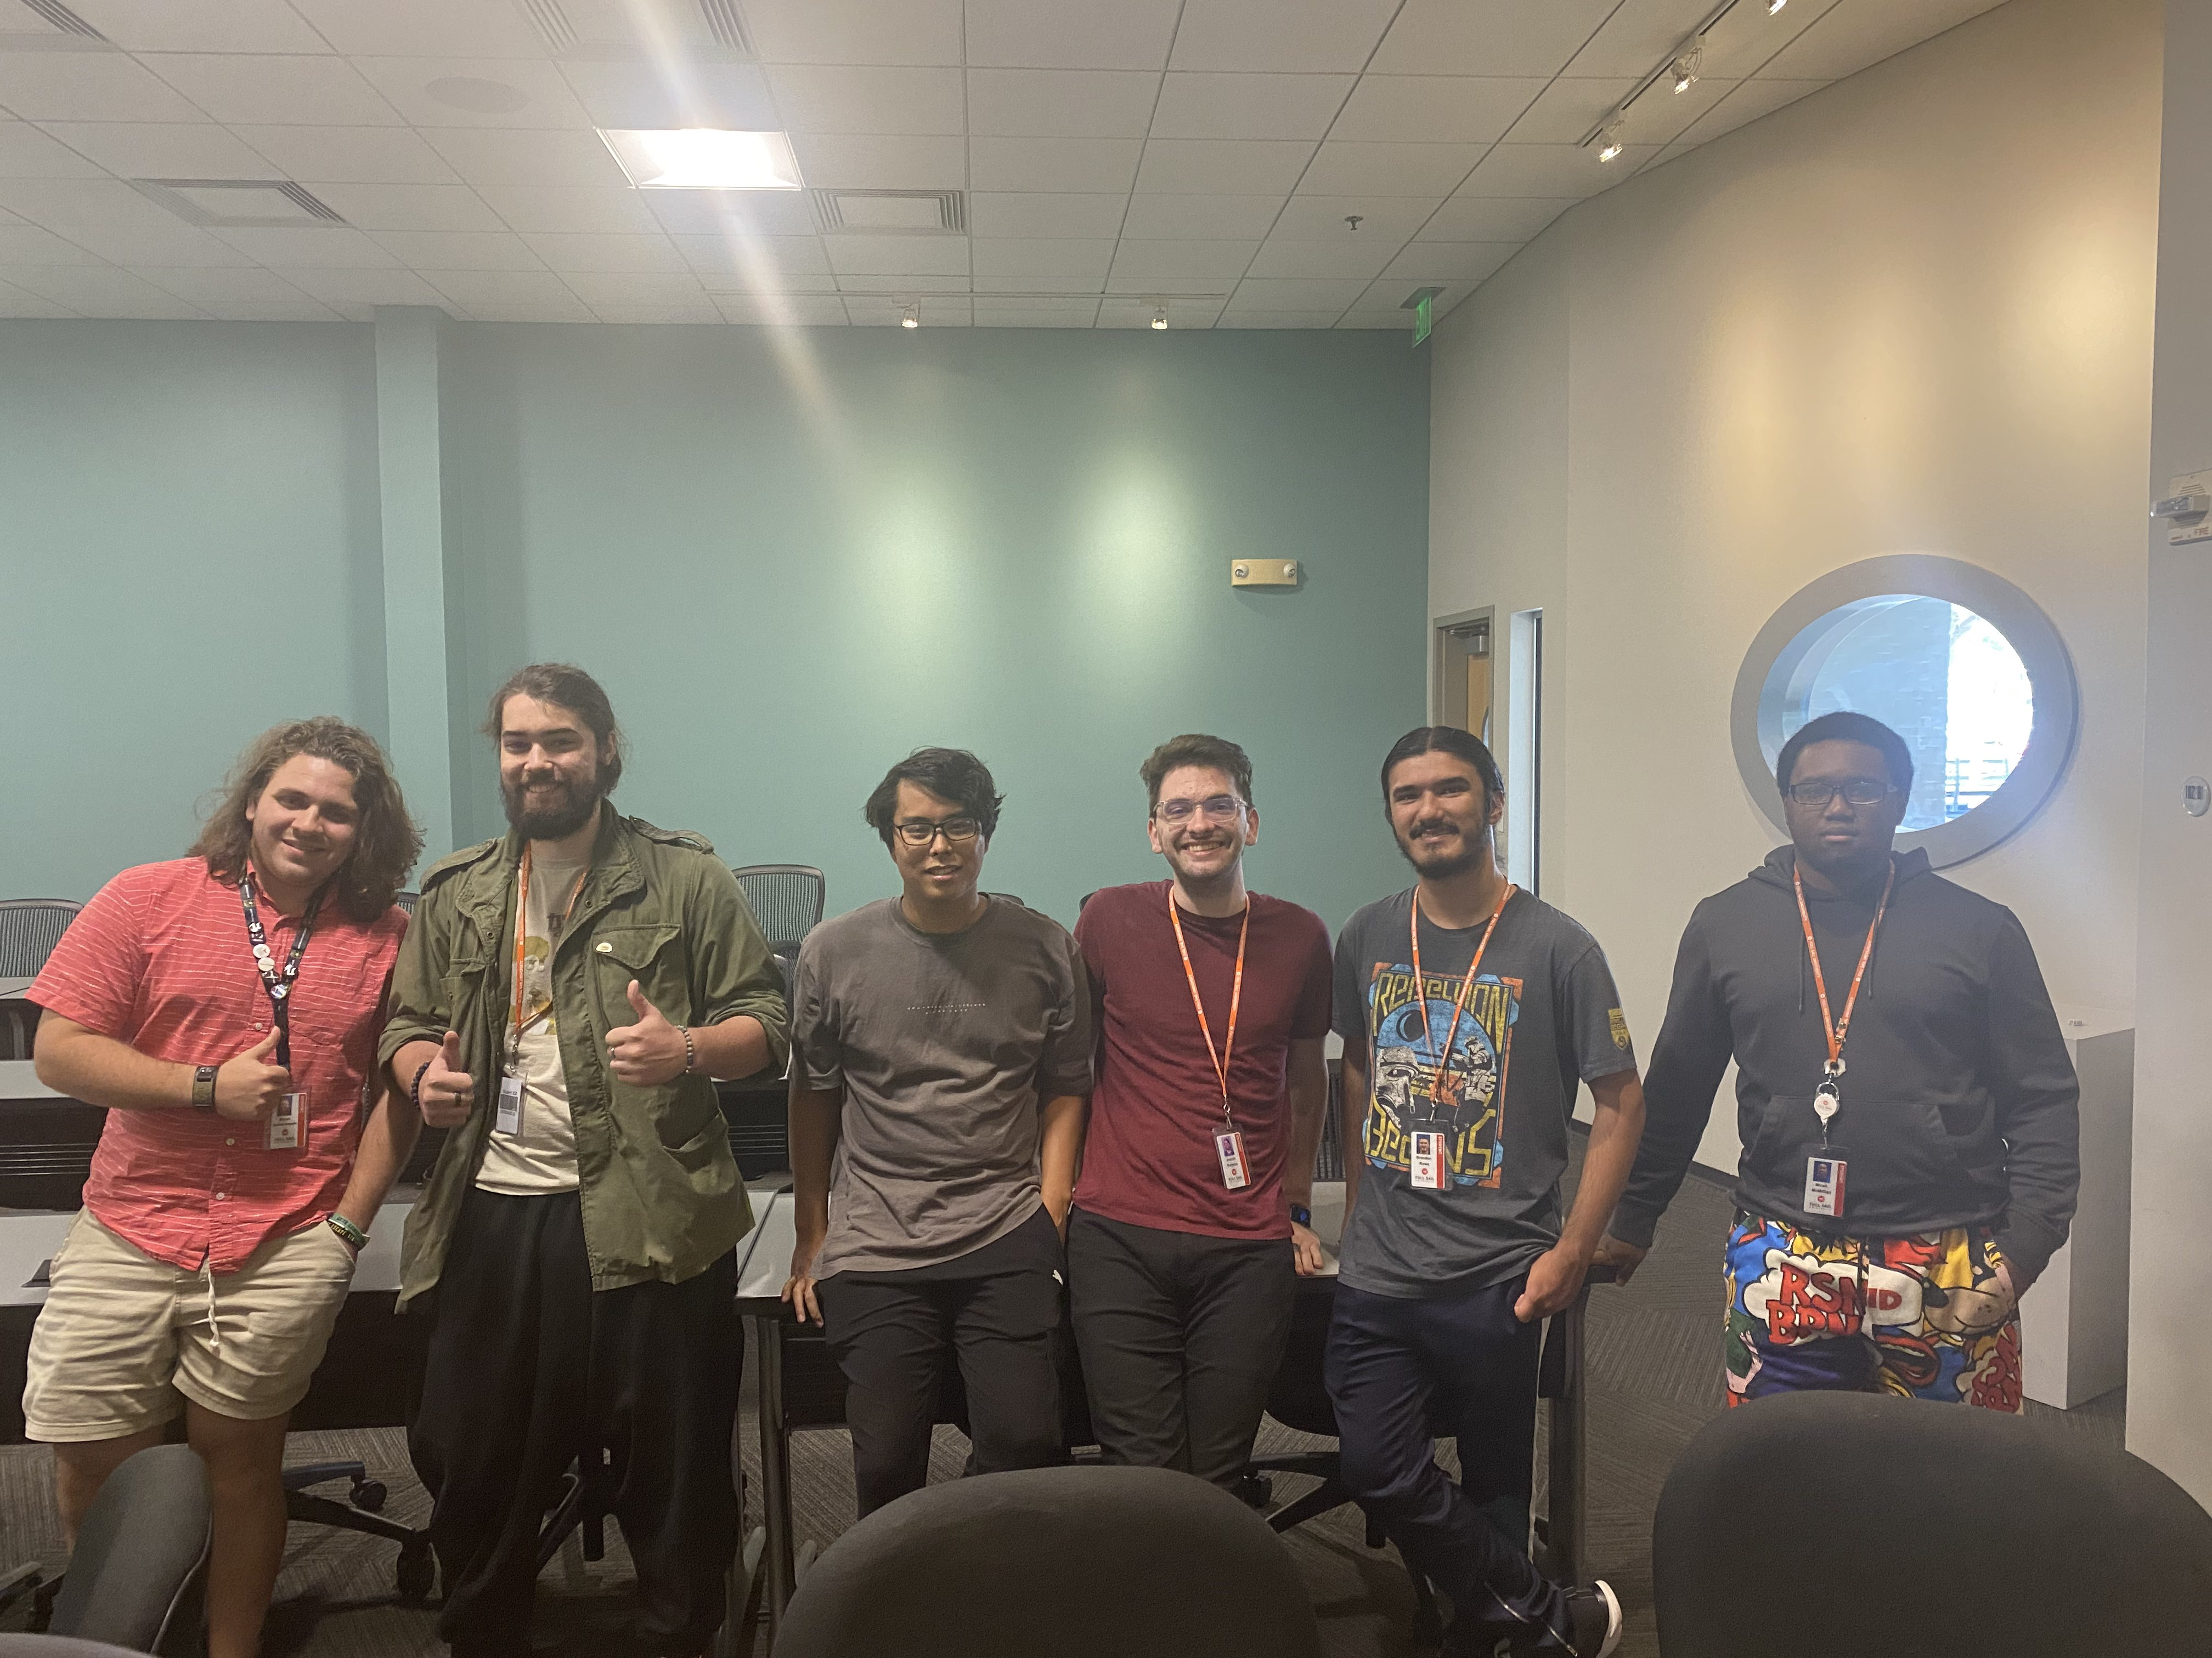
The Team
Bryan Santiago Sinigaglia – Graphics Programmer
Co-creator of the Renderer and Lead UI Designer/ Implementor
Jason Housel– Graphics Programmer
Co-creator of the Renderer and General Team Helper
Xing Jie (Jacob) Zhu – Gameplay Programmer
Physics Programmer
Joe Purpura – Gameplay Programmer
Player Programmer
Brandon Rowe– Lead Programmer
Level/ Asset Designer
Micah McMillian– Lead Programmer
Jira Specialist and collectible programmer

Slide 3
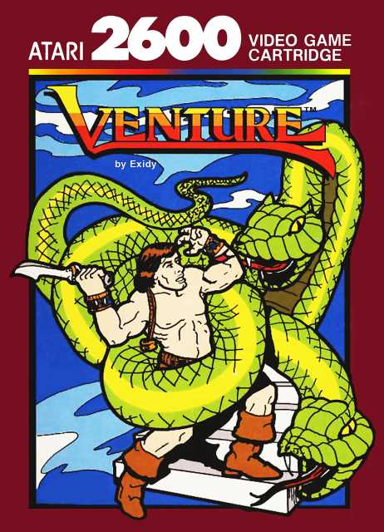
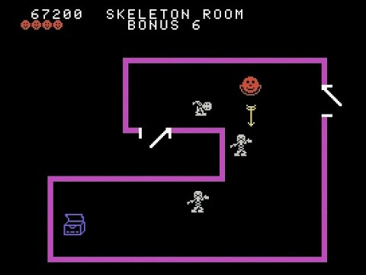
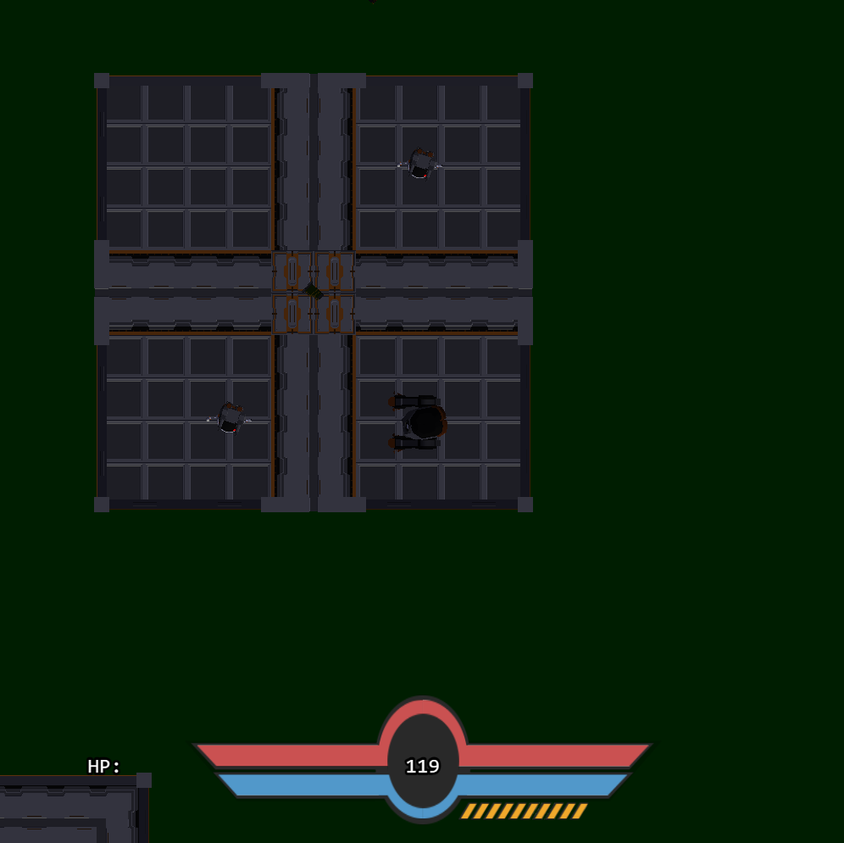
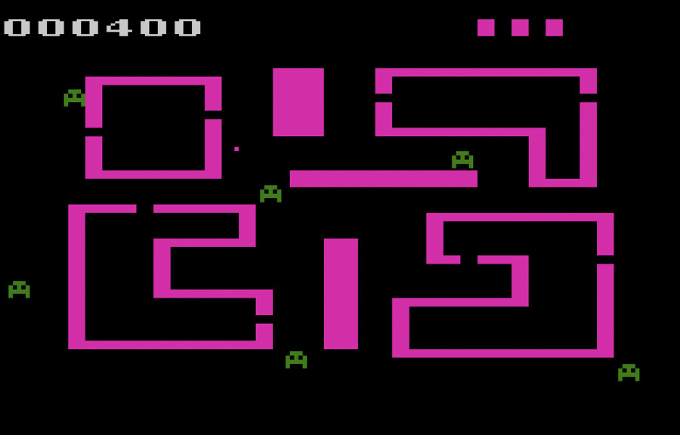
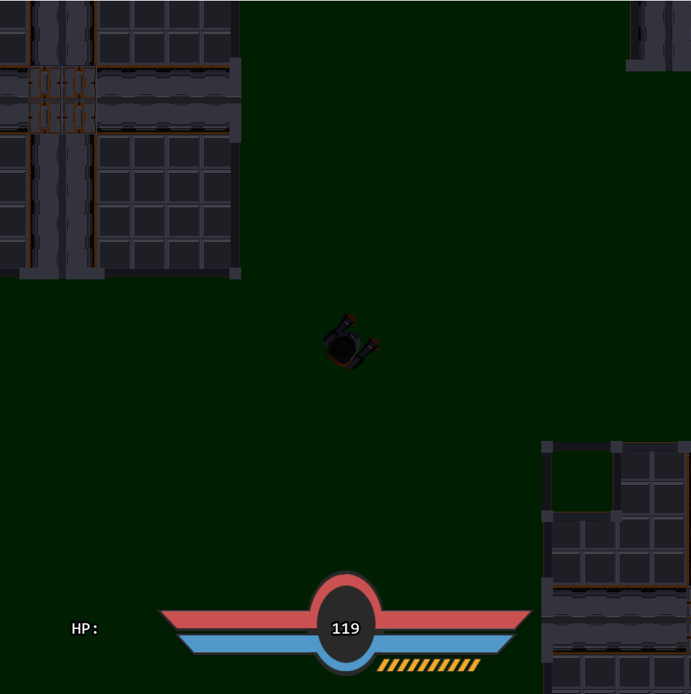
Adventura
Adventura is a top-down collectible shooter In which the player fights enemies to collect treasures and get a high score!
Adventura’s direct inspiration is the ColecoVision/Atari 2600 game “Venture”
Creating Venture was a large undertaking to be made in one month, but with our team of six, we were less limited with what we could do than other teams!
(Demo the game…)

Slide 4
The Goods… and The Not-So Goods
Team coordination
FLECS
Work Delegation
Time Management
Hall of Fame
Hubris

Slide 5
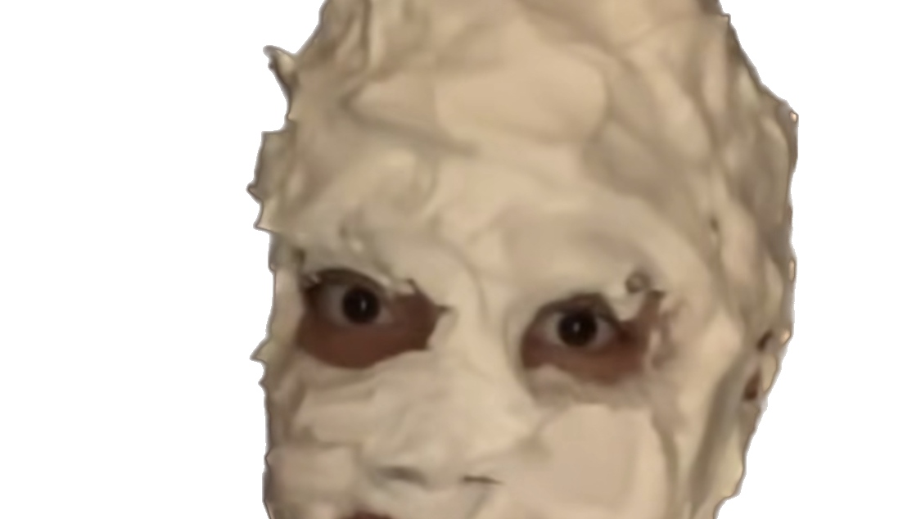
What have we Learned?
ASK FOR HELP
Plan around foreseeable roadblocks effectively
Communication is Key
Burnout is real
Learn to enjoy what you do!

